Slide 1


DATA ANALYST INTERNSHIP
Topic : HR DATA ANALYSIS
BY
PRAFUL DYUNDI

Slide 2
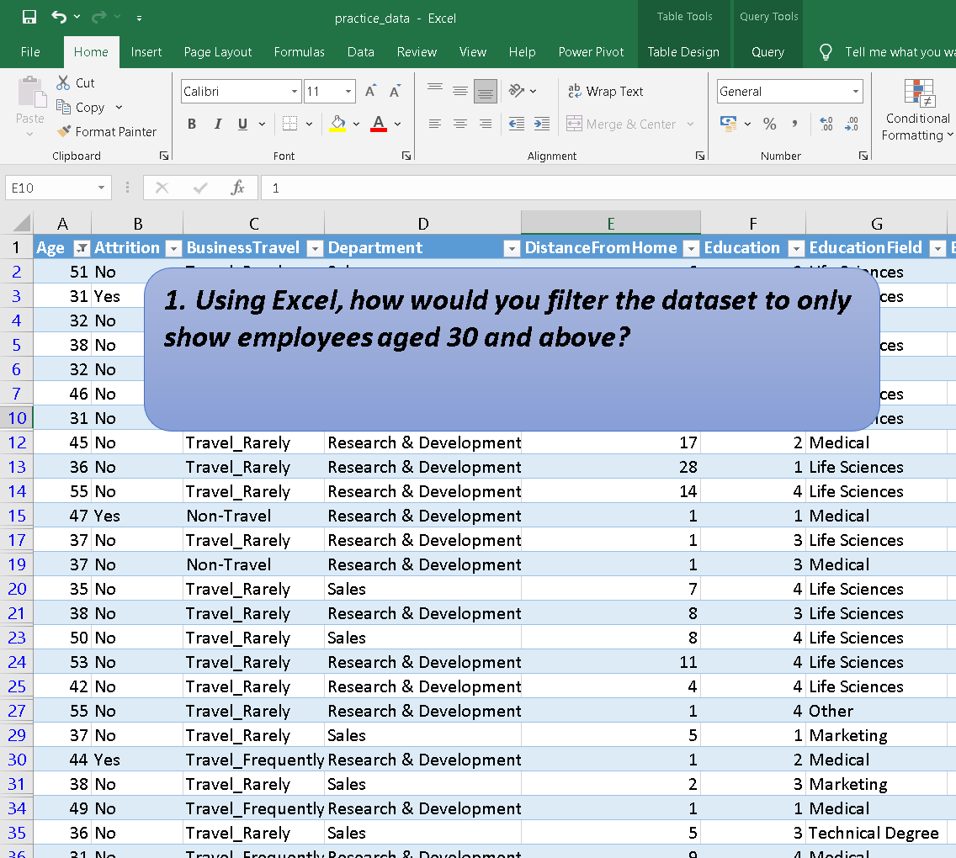

Slide 3
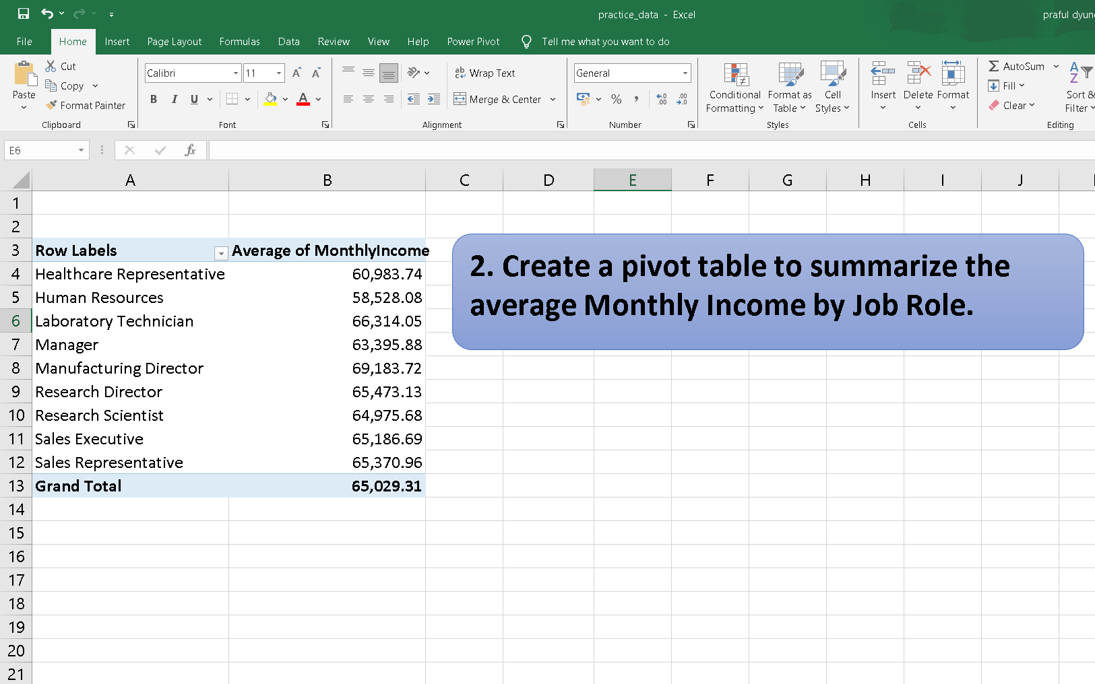

Slide 4
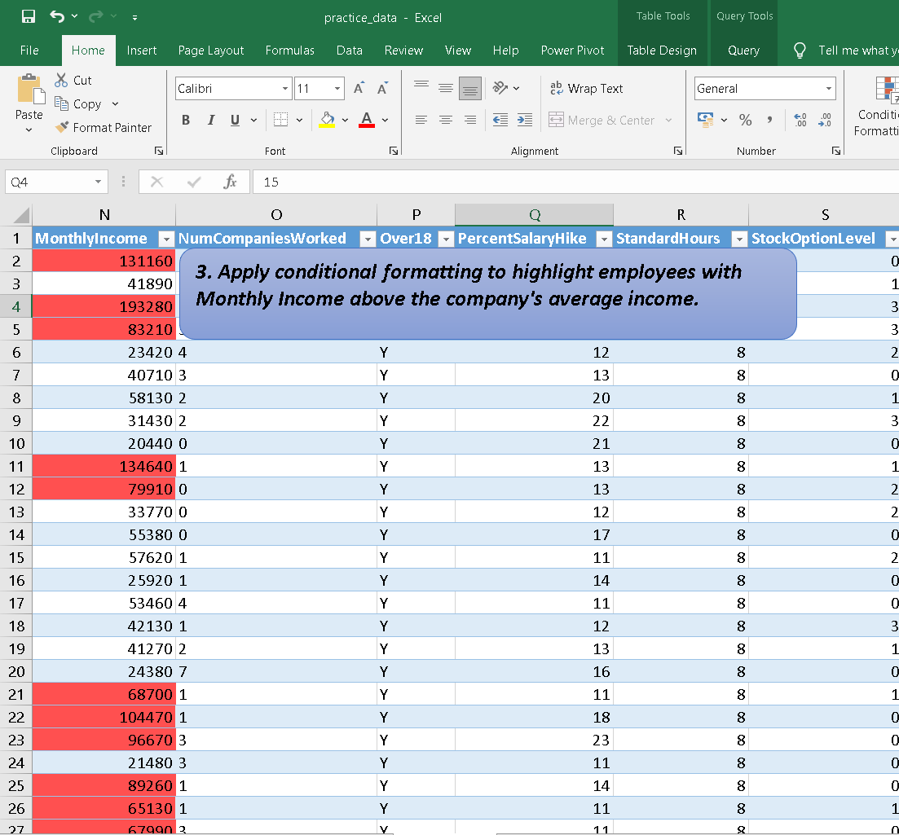

Slide 5
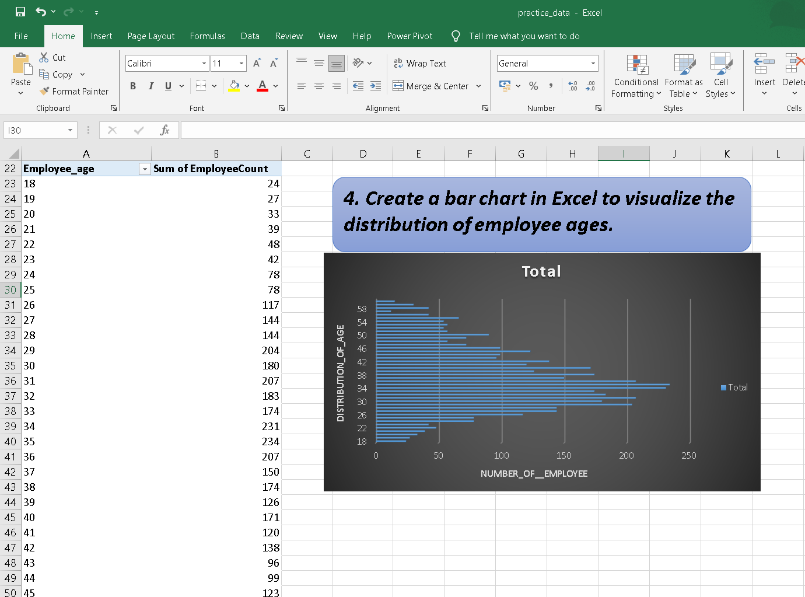

Slide 6
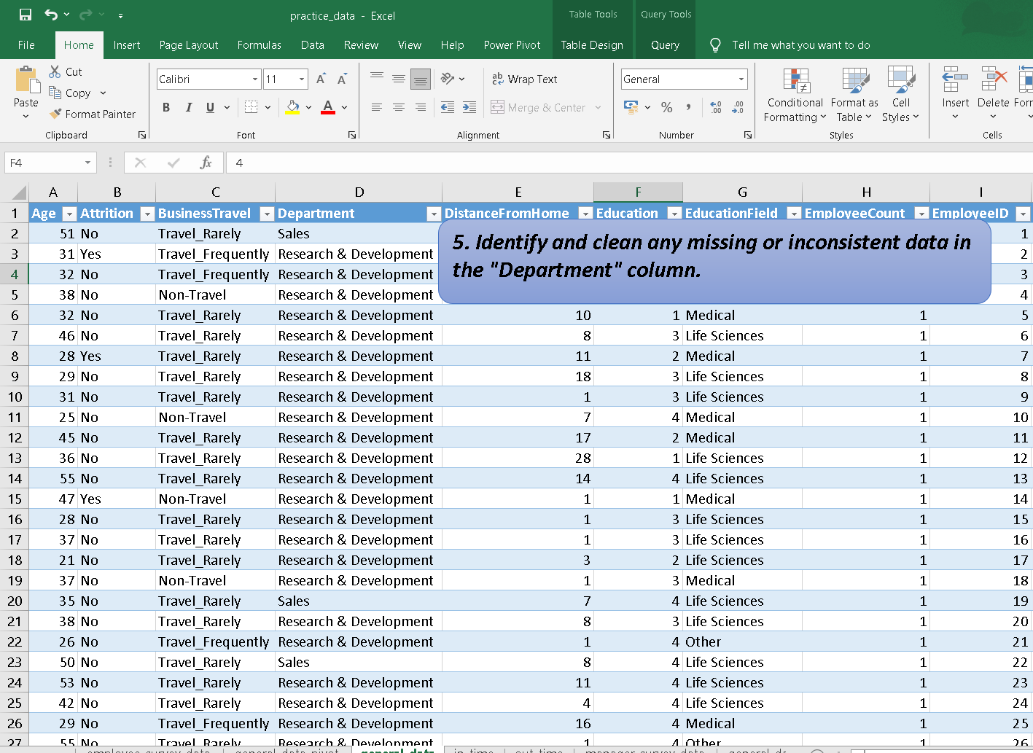

Slide 7
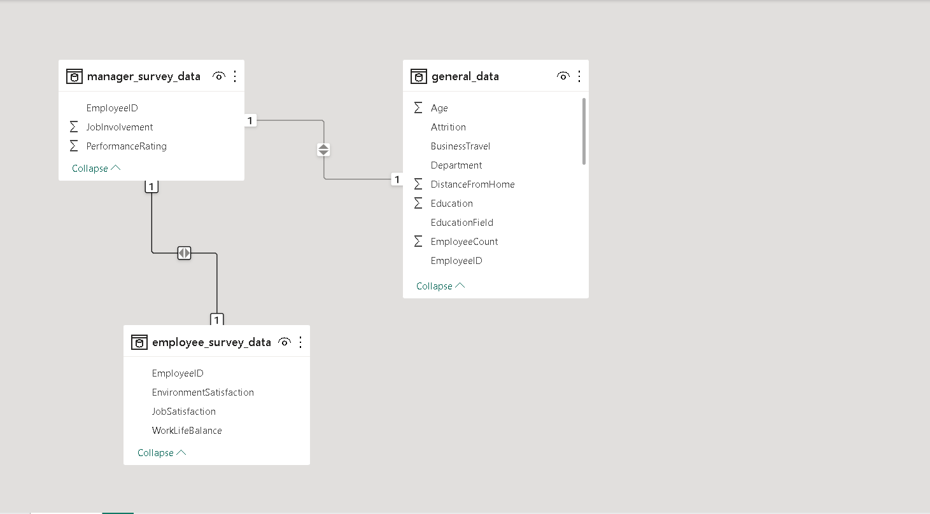
6. In Power BI, establish a relationship between the "EmployeeID" in the employee data and the "EmployeeID" in the time tracking data.

Slide 8
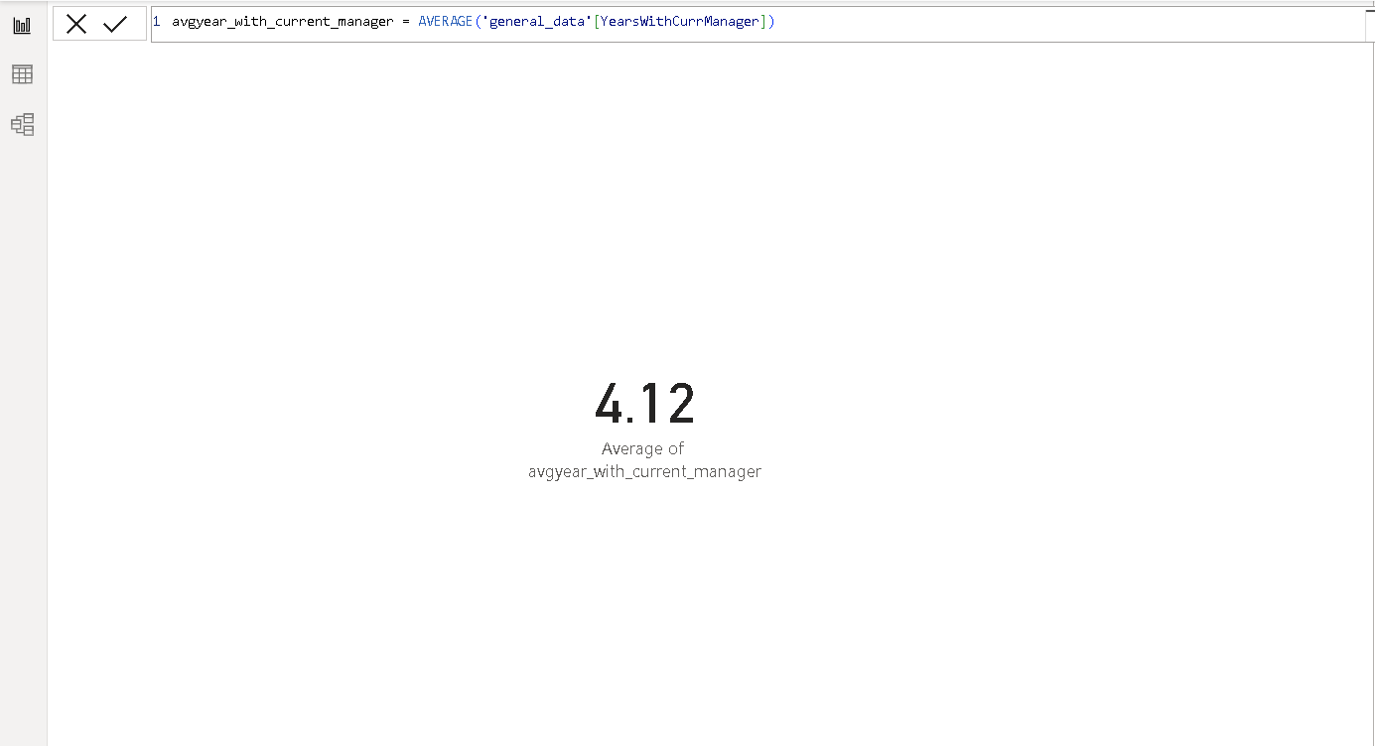
7. Using DAX, create a calculated column that calculates the average years an employee has spent with their current manager.

Slide 9
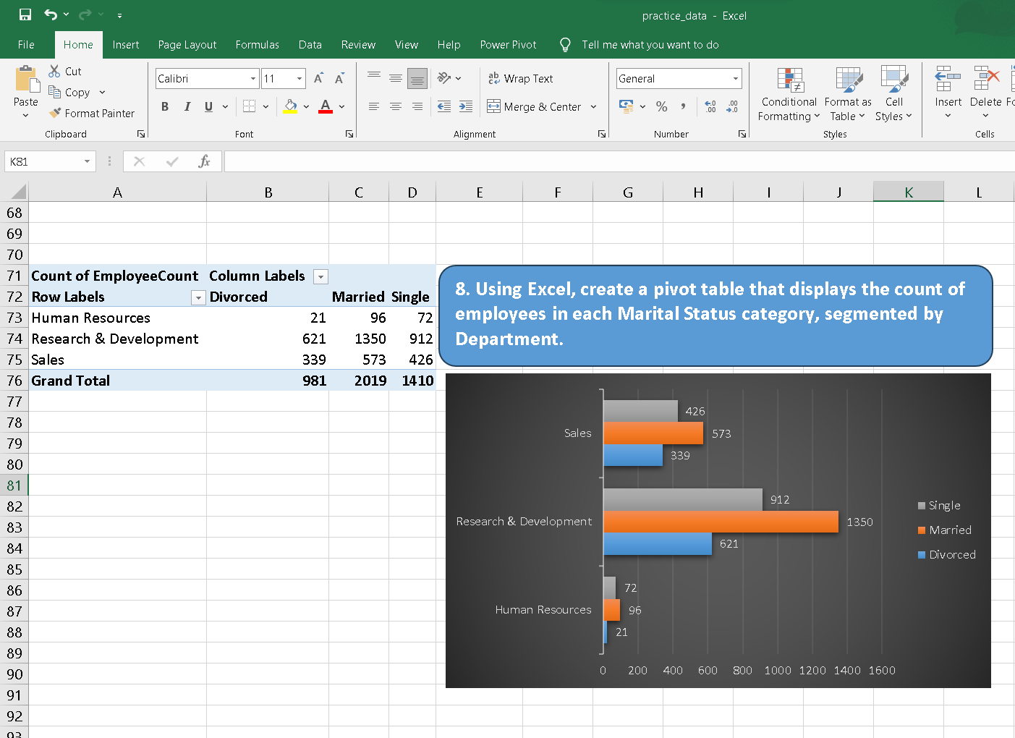

Slide 10
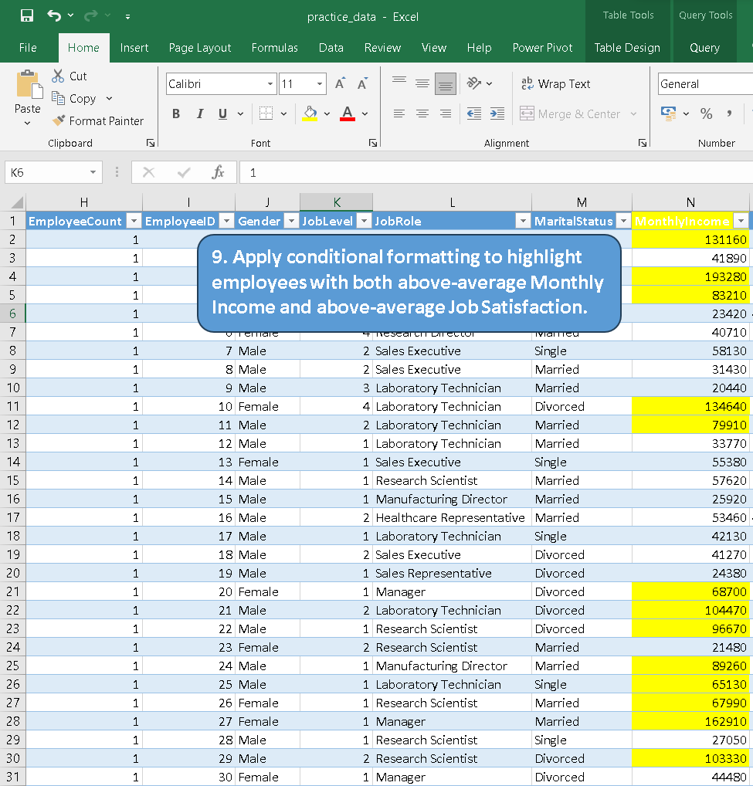
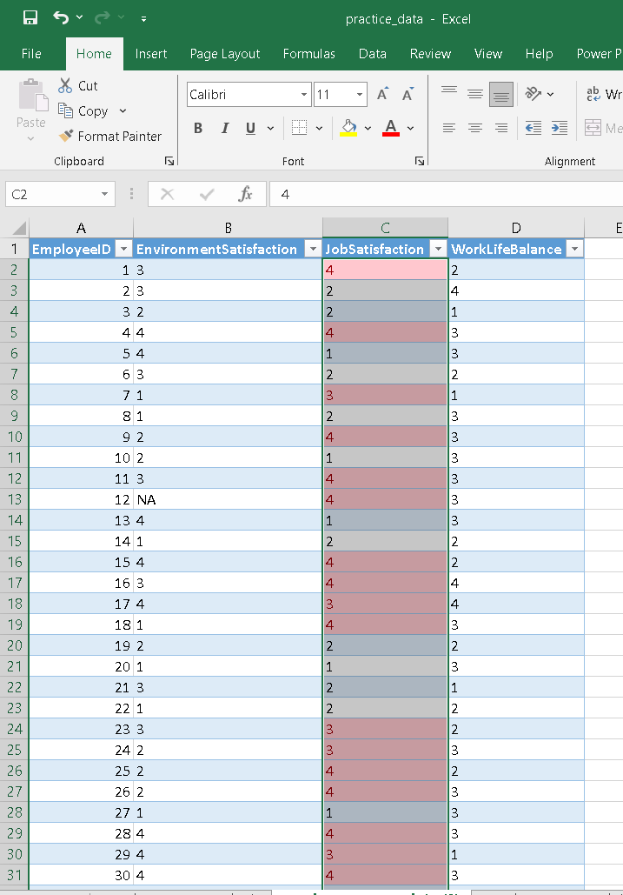

Slide 11
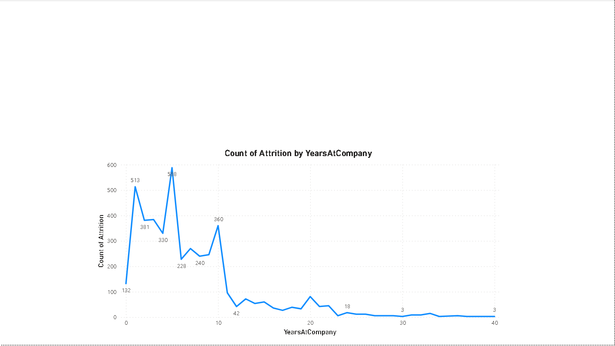
10.In Power BI, create a line chart that visualizes the trend of Employee Attrition over the years.

Slide 12

11. Describe how you would create a star schema for this dataset, explaining the benefits of doing so.
Creating a Star Schema:
1. Identify Fact Table:
- Choose a central table for key business metrics (e.g., sales).
2. Define Dimension Tables:
- Create separate tables for related entities (e.g., product, customer, time).
3. Establish Relationships:
- Connect the fact table to dimension tables using foreign key relationships.
Benefits:
- Simplicity: Easy to understand and navigate.
- Performance: Improved query performance with focused data.
- Scalability: Easily accommodates new dimensions or facts.
- Maintenance: Simplified updates and changes.
- Flexibility: Adaptable to evolving business requirements.
- Data Quality: Enforces referential integrity for better accuracy.
- Aggregation: Facilitates efficient data aggregation.
- Security: Enables granular control over data access.

Slide 13
12. Using DAX, calculate the rolling 3-month average of Monthly Income for each employee.
Rolling 3-Month Average =
CALCULATE(
AVERAGE(‘general_data'[MonthlyIncome]),
FILTER(
ALL(' general_data '),
'Employee_survey_Data'[EmployeeID] = EARLIER('Employee_survey_Data'[EmployeeID])
&& 'EmployeeData'[Date] >= EARLIER('EmployeeData'[Date]) - 90
&& 'EmployeeData'[Date] <= EARLIER('EmployeeData'[Date])
)
)

Slide 14
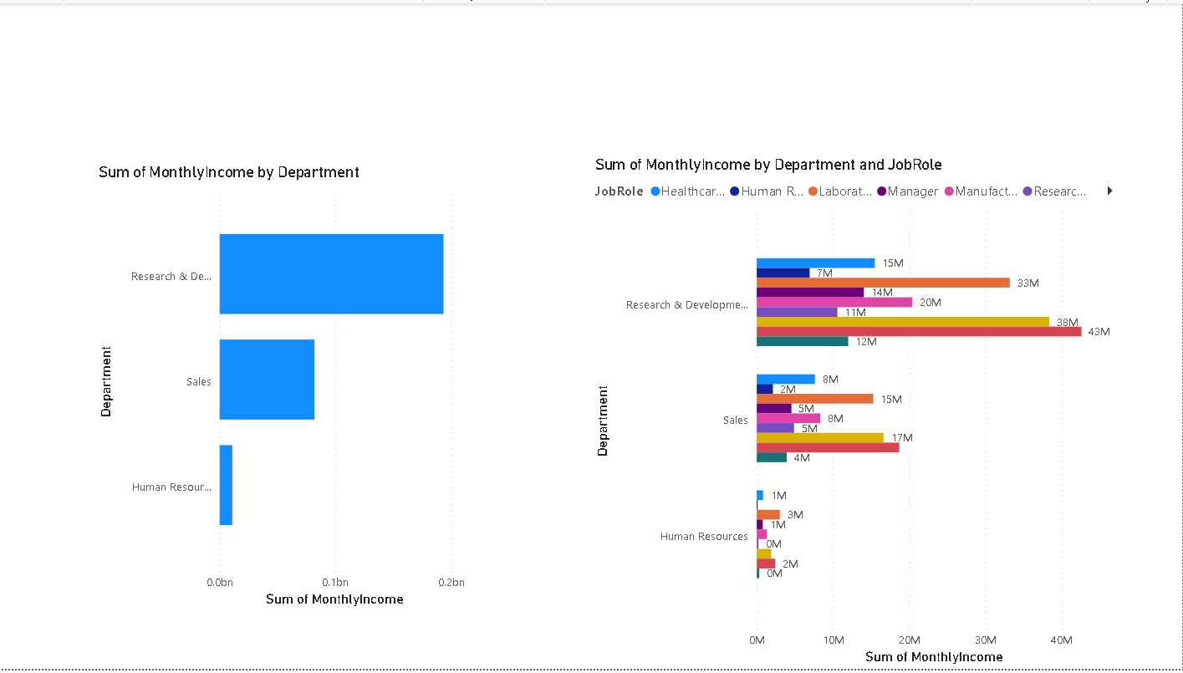
13. Create a hierarchy in Power BI that allows users to drill down from Department to Job Role to further narrow their analysis.

Slide 15
14. How can you set up parameterized queries in Power BI to allow users to filter data based 2 of 2 on the Distance from Home column?
To set up parameterized queries in Power BI based on the "Distance from Home" column:
1. Open Power BI Desktop and load your data.
2. In Power Query, create a parameter (e.g., DistanceParameter) in the Manage Parameters window.
3. In Power Query Editor, filter the "Distance from Home" column using the created parameter.
4. Load the data into Power BI.
5. Create a slicer in the report using the DistanceParameter.
6. Publish the report to the Power BI Service.
7. Users can now interactively filter data based on the "Distance from Home" column using the slicer in the Power BI Service.

Slide 16
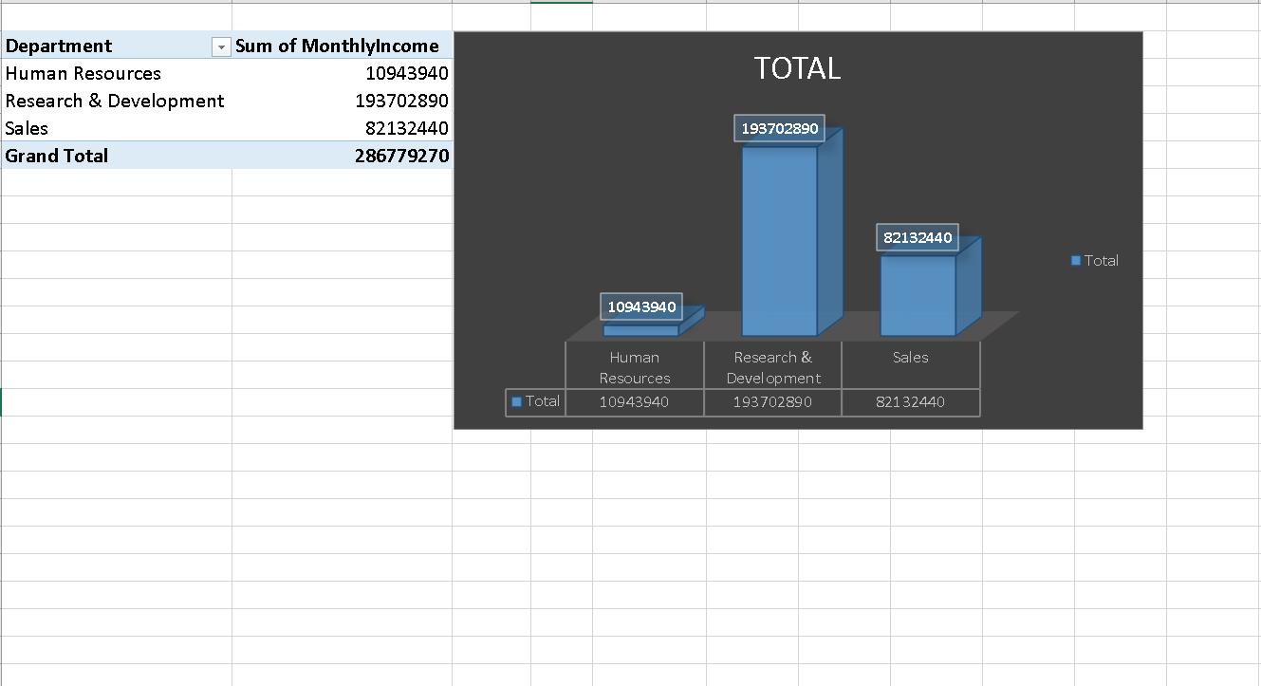
15. In Excel, calculate the total Monthly Income for each Department, considering only the employees with a Job Level greater than or equal to 3.

Slide 17
16. Explain how to perform a What-If analysis in Excel to understand the impact of a 10% increase in Percent Salary Hike on Monthly Income.
Performing a What-If analysis in Excel to understand the impact of a 10% increase in Percent Salary Hike on Monthly Income involves using Excel's built-in tools like Data Tables or Scenario Manager. Here's a brief guide using Data Tables:
1. Set Up Your Spreadsheet:
- In an Excel worksheet, create a table with columns for relevant data (e.g., Monthly Income, Percent Salary Hike, etc.).
- Enter the initial values in the appropriate cells.
2. Enter Formulas:
- Use formulas to calculate Monthly Income based on the initial Percent Salary Hike. For example, if Monthly Income is in cell A1 and
Percent Salary Hike is in cell B1, you might have a formula like `=A1 * (1 + B1)` to calculate the new Monthly Income.
3. Create Data Table
- Select the range of cells containing your formulas.
- Go to the "Data" tab on the Excel ribbon.
- Click on "What-If Analysis" or "Data Table" (the exact wording may vary based on your Excel version).
- In the dialog box, enter the cell reference of the input cell for Percent Salary Hike (e.g., B1) under "Column Input Cell."
- Click OK.
4. Review the Data Table:
- Excel will generate a table showing the impact of different Percent Salary Hike values on Monthly Income.
- Identify the row or column corresponding to a 10% increase in Percent Salary Hike to see the corresponding Monthly Income.

Slide 18
17. Verify if the data adheres to a predefined schema. What actions would you take if you find inconsistencies?
Verifying if data adheres to a predefined schema involves checking whether the data conforms to the expected structure, format, and constraints. Here are steps to verify and actions to take if inconsistencies are found:
1. Verify Data Against Schema:
- Check data structure, types, and constraints against the predefined schema.
2. Identify Inconsistencies:
- Look for missing values, incorrect types, or unexpected data.
3. Log and Communicate:
- Record inconsistencies and notify stakeholders about the findings.
4. Correct Data:
- Fix data to align with the schema; update documentation accordingly.
5. Implement Preventive Measures:
- Improve processes to prevent similar inconsistencies in the future.
6. Revalidate and Monitor:
- Ensure data adherence to the schema post-correction and establish continuous monitoring.

Slide 19
